Slide 1


Git & GitHub
Value Added Program (VAP) • Session 1
Introduction to Version Control and Git
Department of Computer Science & Engineering

Slide 2


Learning Objectives
By the end of this session, students will understand:
▹
What is Version Control?
▹
Why do we need Version Control?
▹
Centralized vs Distributed Version Control
▹
History and evolution of Git
▹
Git vs GitHub
▹
Three important areas of Git
▹
Basic Git terminology

Slide 3


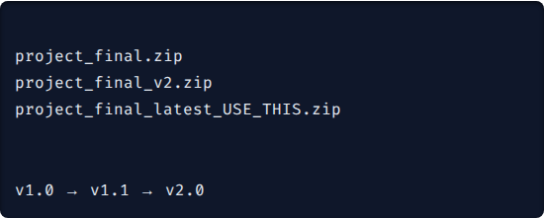
What is Version Control?
Version Control System (VCS) is a software tool used to track changes in files and source code over time.
▹
Maintains different versions of a project.
▹
Helps developers work together concurrently.
▹
Allows restoration of previous stable versions.
▹
Maintains a history of who changed what and when.
# Instead of doing this:
# Git maintains versions systematically:

Slide 4


Why Do We Need Version Control?
Without VCS
With VCS
✗
Difficult to track file changes
✓
Track changes systematically
✗
Accidental deletion can cause data loss
✓
Seamless collaboration
✗
Difficult for multiple developers to work together
✓
Reliable backup and recovery
✓
Complete version history audit trail
✗
Difficult to identify who made a specific change
✓
Powerful branching and merging
✓
Optimized team development
✗
Difficult to return to an older version

Slide 5
Types of Version Control Systems
Architecture Type | Description | Examples
Local Version Control | Versions maintained on a single local computer database. | RCS
Centralized Version Control (CVCS) | Single server stores all versioned files; clients check out files. | SVN, CVS, Perforce
Distributed Version Control (DVCS) | Every developer has a full mirror of the repository and history. | Git, Mercurial
Git belongs to the Distributed Version Control System (DVCS) family.

Slide 6


Local Version Control System
▹
Versions are maintained strictly on a single local computer.
▹
Changes are stored in a local database structure.
▹
Simple to use for solo, small-scale projects.
▹
Example: RCS (Revision Control System)
Critical Limitation: If the local system's hard drive is damaged or corrupted, the entire version history and project data may be permanently lost. Collaboration is also highly restricted.

Slide 7

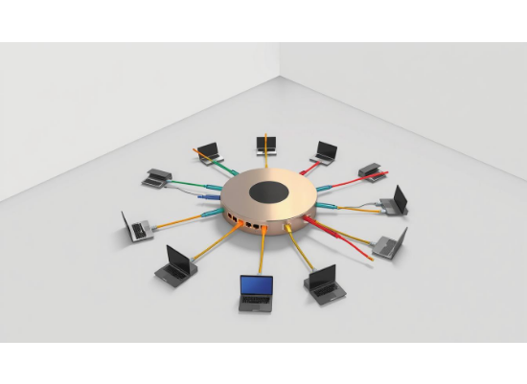

Centralized Version Control System (CVCS)
Architecture Overview:
▹
One central repository server stores the entire project.
▹
Developers connect over a network to the central server.
▹
Users commit changes directly to the central repository.
▹
Users update/checkout files directly from the server.
Common Examples: SVN (Subversion), CVS, Perforce

Slide 8




CVCS: Pros & Cons
Advantages
Disadvantages
✓
Centralized administration and management
✗
Requires constant network/server access
✗
Single point of failure: If the server goes down, nobody can collaborate or save versioned changes
✓
Easy to control user access and permissions
✓
Single authoritative source of truth
✗
Extremely limited offline work capabilities
✓
Suitable for traditional team structures
✗
Slower operations (requires network round-trip)

Slide 9
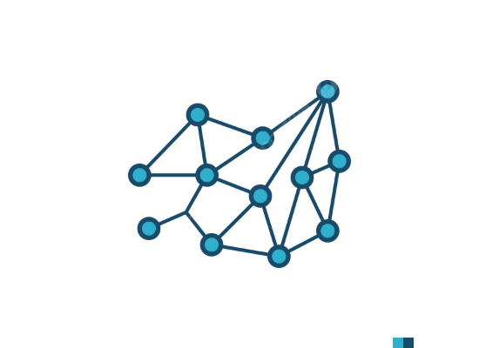
Distributed Version Control System (DVCS)
In DVCS, clients don't just check out the latest snapshot; they fully mirror the repository.
▹
Every developer gets a complete, independent copy of the repository, including its full history.
▹
Each developer can work offline and independently.
▹
Changes are later synchronized between repositories.
▹
If a server dies, any client repository can be copied back to restore it.
Examples: Git, Mercurial

Slide 10
Comparison: Centralized vs Distributed
Feature | Centralized (CVCS) | Distributed (DVCS)
Repository Location | Single Central Server | Every developer has a full copy
Offline Work | Very Limited | Strongly Supported
Server Dependency | High (Constant connection needed) | Lower (Only for syncing)
Backup / Redundancy | Mainly relies on the server backups | Multiple natural copies exist
Speed of Operations | Network dependent (Slower) | Local operations (Very Fast)
Primary Example | SVN | Git

Slide 11

What is Git?
Distributed VCS: Git is a Distributed Version Control System where every user holds a full repository mirror.
Creator: Created by Linus Torvalds (creator of Linux) in 2005.
Origin: Originally developed specifically for managing the massive Linux kernel source code.
Open Source: Completely open-source and free to use.
Performance: Designed inherently for lightning speed, data reliability, and non-linear distributed development.
Key Takeaway: Git tracks snapshots of your project over time locally, not just file differences.

Slide 12
History & Evolution of Git
2005
Today
BitKeeper licensing changed. Linus Torvalds needed a new tool and built Git's first version in weeks.
The most widely used VCS globally. Standard in Dev, Data Science, DevOps, and enterprise tech.
Pre-2005
2005 - 2010s
Linux kernel devs used various messy methods/tools. Later relied on a proprietary tool called BitKeeper.
Git rapidly evolved. GitHub launched in 2008, propelling Git as the default open-source standard.

Slide 13










Design Goals: Why Was Git Created?
Speed
Data Integrity
Distributed
Operations run locally, making branching, merging, and commits incredibly fast.
Every file and commit is checksummed (SHA-1). Impossible to corrupt data unnoticed.
Full offline capabilities and no single point of failure for repositories.
Powerful Branching
Scale
Non-linear development. Create and merge branches instantly without friction.
Designed from day one to handle huge projects (like Linux) and massive teams.

Slide 14




Clarification: Git vs GitHub
Git
GitHub
▹
Tool: The underlying Version Control System software.
▹
Platform: Cloud-based hosting service for Git repositories.
▹
Installed locally on your computer.
▹
Accessed via the internet.
▹
Tracks changes in your files.
▹
Enables remote collaboration and sharing.
▹
Works offline (locally).
▹
Provides UI features: Pull Requests, Issues.
▹
Commands: git init, git add, git commit
▹
Analogy: GitHub is to Git what Instagram is to your camera.

Slide 15






Core Concept: Three Areas of Git
Git manages your local project files across three distinct states.
1. Working Directory
2. Staging Area
3. Git Repository
The local folder on your computer. Contains the files you are currently editing, adding, or deleting. (Untracked / Modified files).
A preparation zone (index). Files you have explicitly selected to be grouped and included in your very next commit.
The local .git database. Contains the safely saved, committed versions and complete history of your project.

Slide 16
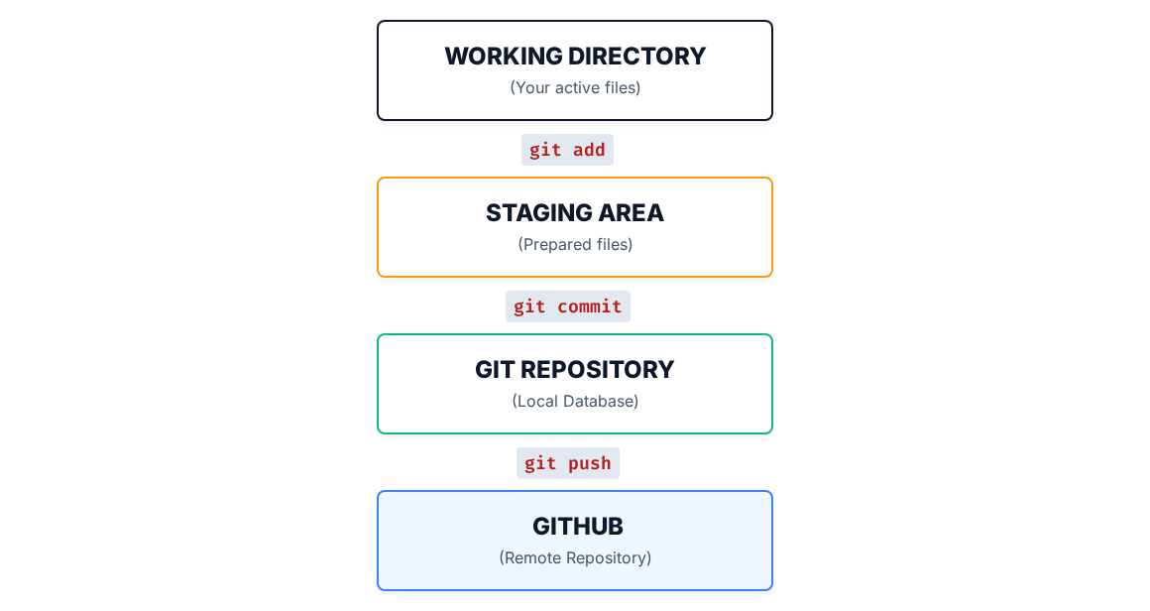
The Git Flow Diagram

Slide 17




Example: Tracking a File
Step 2
Run git add index.html
Step 4
Run git push
Suppose we create a new file called index.html
Step 1
Step 3
Create/modify the file.
Run git commit -m "Added index"

Slide 18
Crucial Git Terminology
▹
Repository (Repo): A directory/project managed by Git, including its history.
▹
Clone: Downloading a full copy of a remote repository to your local machine.
▹
Commit: A saved snapshot of your file changes at a specific point in time.
▹
Push: Uploading your local commits to a remote repository (like GitHub).
▹
Branch: An independent, parallel line of development within the repository.
▹
Pull: Downloading new changes from a remote repository and instantly integrating them.
▹
Merge: Combining changes from one branch into another branch.
▹
Fetch: Downloading remote changes without merging them into your local branch.

Slide 19
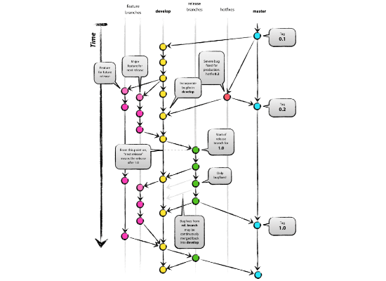
The Standard Git Workflow
This standard loop will be used throughout your development career:
▹
Modify: Edit files in your working directory.
▹
Stage: Select specific changes using git add to prepare for a commit.
▹
Commit: Snapshot the staged files into your local repo using git commit.
▹
Push: Sync your local history to GitHub using git push for backup and collaboration.

Slide 20

Session 1: Quick Recap
Version Control: Tracks file changes systematically over time.
CVCS vs DVCS: Centralized relies on one server; Distributed gives everyone a full copy.
Git: A Distributed Version Control System created by Linus Torvalds in 2005.
Git ≠ GitHub: Git is the local CLI tool; GitHub is the cloud hosting platform.
Three Areas: Working Directory, Staging Area, Local Repository.

Slide 21
Quick Knowledge Check
1. What is Version Control?
2. Give two examples of a Centralized VCS (CVCS).
3. Is Git centralized or distributed?
4. What is the fundamental difference between Git and GitHub?
5. What does the command git add do?
6. What are the three primary state areas in Git?
7. What does git push do?

Slide 22


Hands-On: First Repo
Let's transition to practical application. Open your terminal and follow along:
# Check if Git is installed
$
git --version
# Configure your global user settings
$
git config --global user.name "Your Name"
$
git config --global user.email "your@email.com"
# Create and enter a new project directory
$
mkdir git-project
$
cd git-project
# Initialize the empty Git repository
$
git init
Initialized empty Git repository in /git-project/.git/

Slide 23






Image Sources
https://images.stockcake.com/public/c/c/c/ccc3a7ee-fd94-4111-9352-6cf202c1aab7_large/students-using-laptops-stockcake.jpg
Source: stockcake.com
https://cdn-dynmedia-1.microsoft.com/is/image/microsoftcorp/PCA21_Contextual_1484_RGB?resMode=sharp2&op_usm=1.5,0.65,15,0&wid=752&hei=580&qlt=100&fmt=png-alpha&fit=constrain
Source: www.microsoft.com
https://png.pngtree.com/png-vector/20260310/ourlarge/pngtree-desktop-computer-system-icon-vector-png-image_18882496.webp
Source: pngtree.com
https://synchronet.net/wp-content/uploads/2025/03/star-topology.jpeg
Source: synchronet.net
https://png.pngtree.com/png-clipart/20230813/original/pngtree-distribution-network-flat-icon-internet-technology-node-vector-png-image_10316417.png
Source: pngtree.com
https://nvie.com/img/git-model@2x.png
Source: nvie.com

Slide 24


Image Sources
https://images.stockcake.com/public/5/7/b/57bfe6ac-e248-4b4d-b9ee-086d261513eb_medium/night-programming-session-stockcake.jpg
Source: stockcake.com
https://png.pngtree.com/thumb_back/fh260/background/20260619/pngtree-abstract-digital-network-with-glowing-nodes-and-connections-image_21938351.webp
Source: pngtree.com

